Slide 1
UNIT 2
OOP USING PYTHON

Slide 2

Handling Exceptions :

Slide 3
Error in Python can be of two types i.e. Syntax errors and Exceptions. Errors are the problems in a program due to which the program will stop the execution. On the other hand, exceptions are raised when some internal events occur which changes the normal flow of the program.

Slide 4
Syntax errors occur when the parser detects an incorrect statement. Observe the following example:
>>> print( 0 / 0 ))
File "<stdin>", line 1
print( 0 / 0 ))
^
SyntaxError: invalid syntax
The arrow indicates where the parser ran into the syntax error. In this example, there was one bracket too many. Remove it and run your code again:

Slide 5
>>> print( 0 / 0)
Traceback (most recent call last):
File "<stdin>", line 1, in <module>
ZeroDivisionError: integer division or modulo by zero

Slide 6
This time, you ran into an exception error. This type of error occurs whenever syntactically correct Python code results in an error. The last line of the message indicated what type of exception error you ran into.

Slide 7
Instead of showing the message exception error, Python details what type of exception error was encountered. In this case, it was a ZeroDivisionError. Python comes with various built-in exceptions as well as the possibility to create self-defined exceptions.

Slide 8
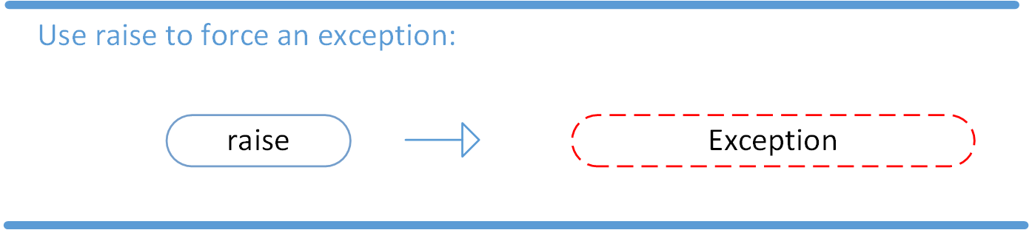
Raising an Exception
We can use raise to throw an exception if a condition occurs. The statement can be complemented with a custom exception.

Slide 9
If you want to throw an error when a certain condition occurs using raise, you could go about it like this:
x = 10
if x > 5:
raise Exception('x should not exceed 5. The value of x was: {}'.format(x))

Slide 10
When you run this code, the output will be the following:
Traceback (most recent call last):
File "<input>", line 4, in <module>
Exception: x should not exceed 5. The value of x was: 10
The program comes to a halt and displays our exception to screen, offering clues about what went wrong.

Slide 11
Sr.No. | Exception Name & Description
1 | Exception Base class for all exceptions
2 | StopIteration Raised when the next() method of an iterator does not point to any object.
3 | SystemExit Raised by the sys.exit() function.

Slide 12
4 | StandardError Base class for all built-in exceptions except StopIteration and SystemExit.
5 | ArithmeticError Base class for all errors that occur for numeric calculation.

Slide 13
8 | ZeroDivisionError Raised when division or modulo by zero takes place for all numeric types.
9 | AssertionError Raised in case of failure of the Assert statement.

Slide 14
The AssertionError Exception
Instead of waiting for a program to crash midway, you can also start by making an assertion in Python. We assert that a certain condition is met. If this condition turns out to be True, then that is excellent! The program can continue. If the condition turns out to be False, you can have the program throw an AssertionError exception.

Slide 15
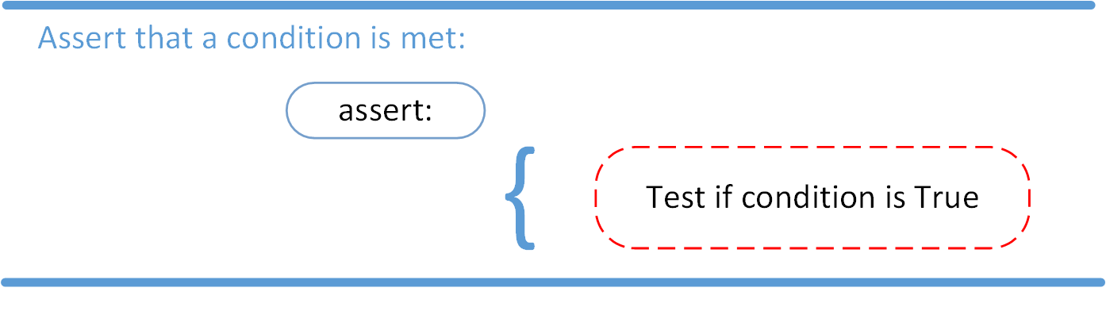

Slide 16
Have a look at the following example, where it is asserted that the code will be executed on a Linux system:
import sys
assert ('linux' in sys.platform), "This code runs on Linux only."

Slide 17
Traceback (most recent call last):
File "<input>", line 2, in <module>
AssertionError: This code runs on Linux only.
In this example, throwing an AssertionError exception is the last thing that the program will do. The program will come to halt and will not continue. What if that is not what you want?

Slide 18
The try and except Block: Handling Exceptions
The try and except block in Python is used to catch and handle exceptions. Python executes code following the try statement as a “normal” part of the program. The code that follows the except statement is the program’s response to any exceptions in the preceding try clause.

Slide 19
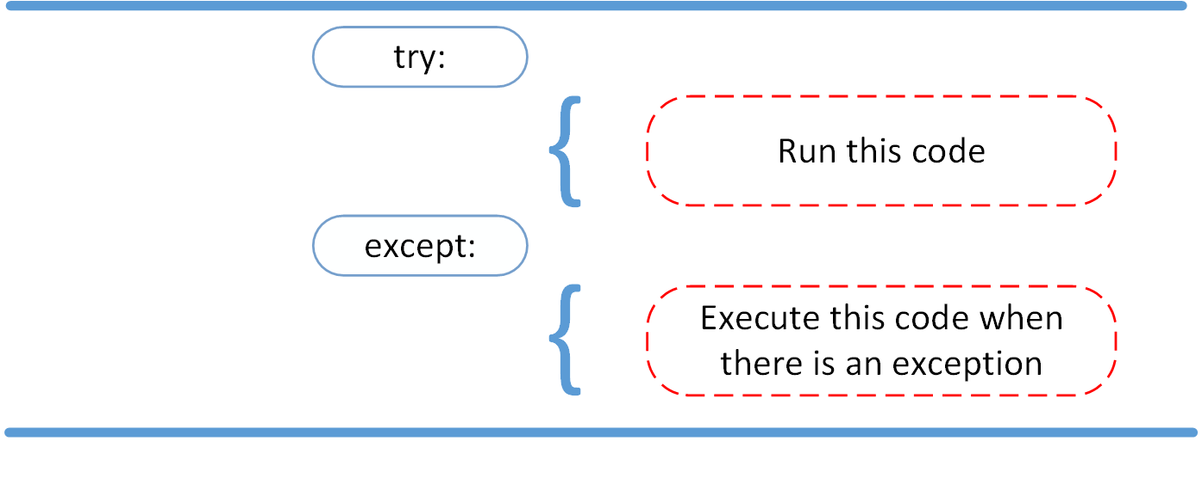

Slide 20
As you saw earlier, when syntactically correct code runs into an error, Python will throw an exception error. This exception error will crash the program if it is unhandled. The except clause determines how your program responds to exceptions.
The following function can help you understand the try and except block:
def linux_interaction():
assert ('linux' in sys.platform), "Function can only run on Linux systems."
print('Doing something.')

Slide 21
The linux_interaction() can only run on a Linux system. The assert in this function will throw an AssertionError exception if you call it on an operating system other then Linux.
You can give the function a try using the following code:
try:
linux_interaction()
except:
pass

Slide 22
The way you handled the error here is by handing out a pass. If you were to run this code on a Windows machine, you would get the following output:
You got nothing. The good thing here is that the program did not crash. But it would be nice to see if some type of exception occurred whenever you ran your code. To this end, you can change the pass into something that would generate an informative message, like so:

Slide 23
try:
linux_interaction()
except:
print('Linux function was not executed')

Slide 24
Execute this code on a Windows machine:
Linux function was not executed

Slide 25
When an exception occurs in a program running this function, the program will continue as well as inform you about the fact that the function call was not successful.
What you did not get to see was the type of error that was thrown as a result of the function call. In order to see exactly what went wrong, you would need to catch the error that the function threw.

Slide 26
The following code is an example where you capture the AssertionError and output that message to screen:
try:
linux_interaction()
except AssertionError as error:
print(error)
print('The linux_interaction() function was not executed')
Running this function on a Windows machine outputs the following:
Function can only run on Linux systems.
The linux_interaction() function was not executed

Slide 27
The first message is the AssertionError, informing you that the function can only be executed on a Linux machine. The second message tells you which function was not executed.
In the previous example, you called a function that you wrote yourself. When you executed the function, you caught the AssertionError exception and printed it to screen.

Slide 28
Example
Here is a function that converts a temperature from degrees Kelvin to degrees Fahrenheit. Since zero degrees Kelvin is as cold as it gets, the function bails out if it sees a negative temperature −
def KelvinToFahrenheit(Temperature):
assert (Temperature >= 0),"Colder than absolute zero!"
return ((Temperature-273)*1.8)+32
print KelvinToFahrenheit(273)
print int(KelvinToFahrenheit(505.78))
print KelvinToFahrenheit(-5)

Slide 29
When the above code is executed, it produces the following result −
32.0
451
Traceback (most recent call last):
File "test.py", line 9, in <module>
print KelvinToFahrenheit(-5)
File "test.py", line 4, in KelvinToFahrenheit
assert (Temperature >= 0),"Colder than absolute zero!"
AssertionError: Colder than absolute zero!

Slide 30
The example below accepts two numbers from the user and performs their division. It demonstrates the uses of else and finally blocks.
Example:
try:
print("try block")
x=int(input('Enter a number: '))
y=int(input('Enter another number: '))
z=x/y

Slide 31
except ZeroDivisionError:
print("except ZeroDivisionError block")
print("Division by 0 not accepted")
else:
print("else block")
print("Division = ", z)
finally:
print("finally block")
x=0
y=0
print ("Out of try, except, else and finally blocks." )

Slide 32
The first run is a normal case. The out of the else and finally blocks is displayed because the try block is error-free.
Result:
try block
Enter a number: 10
Enter another number: 2
else block
Division = 5.0
finally block
Out of try, except, else and finally blocks.

Slide 33
Raise an Exception
Python also provides the raise keyword to be used in the context of exception handling. It causes an exception to be generated explicitly. Built-in errors are raised implicitly. However, a built-in or custom exception can be forced during execution.
The following code accepts a number from the user. The try block raises a ValueError exception if the number is outside the allowed range.

Slide 34
Example:
try:
x=int(input('Enter a number upto 100: '))
if x > 100:
raise ValueError(x)
except ValueError:
print(x, "is out of allowed range")
else:
print(x, "is within the allowed range")

Slide 35
Result:
Enter a number upto 100: 200
200 is out of allowed range
Enter a number upto 100: 50
50 is within the allowed range

Slide 36
Exception as a control flow mechanism :
There’s one other form of flow control that is common within Python, exception handling.
One thing that differs compared to many other languages is that in Python exceptions are relatively lightweight. This means they aren’t only meant to be used in the most extreme circumstances, instead it is not uncommon to use them as a type of control flow.

Slide 37
Example:
try:
a = int(input("Enter a:"))
b = int(input("Enter b:"))
c = a/b
print("a/b = %d"%c)
# Using Exception with except statement. If we print(Exception) it will return exception class
except Exception:
print("can't divide by zero")
print(Exception)
else:
print("Hi I am else block")

Slide 38
Output:
Enter a:10
Enter b:0
can't divide by zero
<class 'Exception'>

Slide 39
The except statement with no exception
Python provides the flexibility not to specify the name of exception with the exception statement.
Example
try:
a = int(input("Enter a:"))
b = int(input("Enter b:"))
c = a/b;
print("a/b = %d"%c)
except:
print("can't divide by zero")
else:
print("Hi I am else block")

Slide 40
The except statement using with exception variable
We can use the exception variable with the except statement. It is used by using the as keyword. this object will return the cause of the exception. Consider the following example:

Slide 41
try:
a = int(input("Enter a:"))
b = int(input("Enter b:"))
c = a/b
print("a/b = %d"%c)
# Using exception object with the except statement
except Exception as e:
print("can't divide by zero")
print(e)
else:
print("Hi I am else block")

Slide 42
Output:
Enter a:10
Enter b:0
can't divide by zero
division by zero

Slide 43
Abstract Data Types :
The abstract data type is special kind of data type, whose behavior is defined by a set of values and set of operations. The keyword “Abstract” is used as we can use these data types, we can perform different operations. But how those operations are working that is totally hidden from the user. The ADT is made of primitive data types, but operation logics are hidden.
Some examples of ADT are Stack, Queue, List etc.

Slide 44
The definition of ADT only mentions what operations are to be performed but not how these operations will be implemented. It does not specify how data will be organized in memory and what algorithms will be used for implementing the operations. It is called “abstract” because it gives an implementation-independent view. The process of providing only the essentials and hiding the details is known as abstraction.

Slide 45
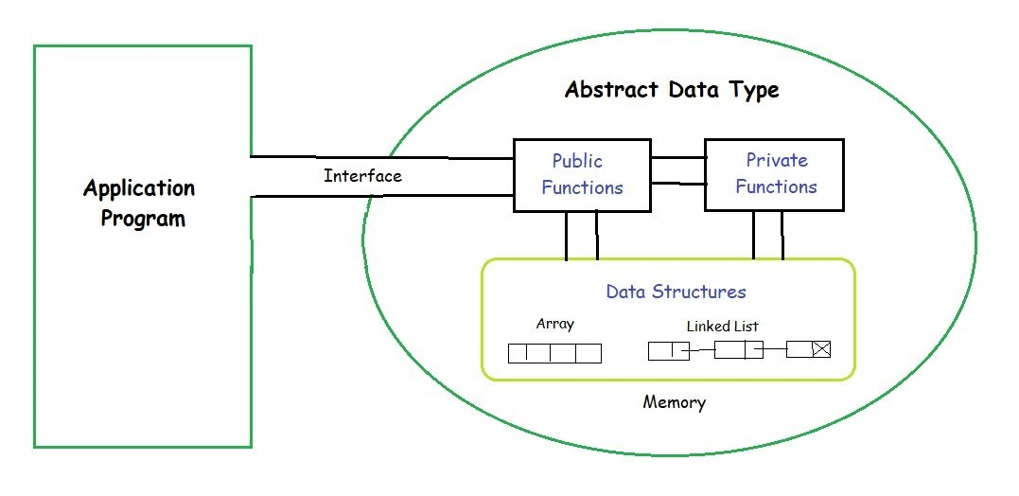

Slide 46
The user of data type does not need to know how that data type is implemented, for example, we have been using Primitive values like int, float, char data types only with the knowledge that these data type can operate and be performed on without any idea of how they are implemented.

Slide 47
So a user only needs to know what a data type can do, but not how it will be implemented. Think of ADT as a black box which hides the inner structure and design of the data type. Now we’ll define three ADTs namely List ADT, Stack ADT, Queue ADT.

Slide 48
Python Classes :
Python is an object oriented programming language.
Almost everything in Python is an object, with its properties and methods.
A Class is like an object constructor, or a "blueprint" for creating objects.

Slide 49
To create a class, use the keyword class:
Example
Create a class named MyClass, with a property named x:
class MyClass:
x = 5

Slide 50
Now we can use the class named MyClass to create objects:
Example
Create an object named p1, and print the value of x:
p1 = MyClass()
print(p1.x)

Slide 51
The first string inside the class is called docstring and has a brief description about the class. Although not mandatory, this is highly recommended.
Here is a simple class definition.
class MyNewClass:
'''This is a docstring. I have created a new class'''
pass

Slide 52
There are also special attributes in it that begins with double underscores __. For example, __doc__ gives us the docstring of that class.
class Person:
"This is a person class"
age = 10
def greet(self):
print('Hello')
# Output: 10
print(Person.age)
# Output: <function Person.greet>
print(Person.greet)
# Output: 'This is my second class'
print(Person.__doc__)

Slide 53
Output
10
<function Person.greet at 0x7fc78c6e8160>
This is a person class

Slide 54
Creating an Object in Python
We saw that the class object could be used to access different attributes.
It can also be used to create new object instances (instantiation) of that class. The procedure to create an object is similar to a function call.
>>> harry = Person()

Slide 55
This will create a new object instance named harry. We can access the attributes of objects using the object name prefix.
Attributes may be data or method. Methods of an object are corresponding functions of that class.
This means to say, since Person.greet is a function object (attribute of class), Person.greet will be a method object.

Slide 56
class Person:
"This is a person class"
age = 10
def greet(self):
print('Hello')
# create a new object of Person class
harry = Person()
# Output: <function Person.greet>
print(Person.greet)
# Output: <bound method Person.greet of <__main__.Person object>>
print(harry.greet)
# Calling object's greet() method
# Output: Hello
harry.greet()

Slide 57
You may have noticed the self parameter in function definition inside the class but we called the method simply as harry.greet() without any arguments. It still worked.
This is because, whenever an object calls its method, the object itself is passed as the first argument. So, harry.greet() translates into Person.greet(harry).

Slide 58
In general, calling a method with a list of n arguments is equivalent to calling the corresponding function with an argument list that is created by inserting the method's object before the first argument.
For these reasons, the first argument of the function in class must be the object itself. This is conventionally called self. It can be named otherwise but we highly recommend to follow the convention.

Slide 59
Output
<function Person.greet at 0x7fd288e4e160>
<bound method Person.greet of <__main__.Person object at 0x7fd288e9fa30>>
Hello

Slide 60
The __init__() Function
The examples above are classes and objects in their simplest form, and are not really useful in real life applications.
To understand the meaning of classes we have to understand the built-in __init__() function.
All classes have a function called __init__(), which is always executed when the class is being initiated.
Note: The __init__() function is called automatically every time the class is being used to create a new object. It can also be considered as constructor.
Use the __init__() function to assign values to object properties, or other operations that are necessary to do when the object is being created:

Slide 61
Example
Create a class named Person, use the __init__() function to assign values for name and age:
class Person:
def __init__(self, name, age):
self.name = name
self.age = age
p1 = Person("John", 36)
print(p1.name)
print(p1.age)

Slide 62
Inheritance
Inheritance allows us to define a class that inherits all the methods and properties from another class.
Parent class is the class being inherited from, also called base class.
Child class is the class that inherits from another class, also called derived class.

Slide 63
Inheritance Syntax
class BaseClass:
Body of base class
class DerivedClass(BaseClass):
Body of derived class
Derived class inherits features from the base class where new features can be added to it. This results in re-usability of code.

Slide 64
Example of Inheritance in Python
A polygon is a closed figure with 3 or more sides. Say, we have a class called Polygon defined as follows.
class Polygon:
def __init__(self, no_of_sides):
self.n = no_of_sides
self.sides = [0 for i in range(no_of_sides)]
def inputSides(self):
self.sides = [float(input("Enter side "+str(i+1)+" : ")) for i in range(self.n)]
def dispSides(self):
for i in range(self.n):
print("Side",i+1,"is",self.sides[i])

Slide 65
This class has data attributes to store the number of sides n and magnitude of each side as a list called sides.
The inputSides() method takes in the magnitude of each side and dispSides() displays these side lengths.
A triangle is a polygon with 3 sides. So, we can create a class called Triangle which inherits from Polygon. This makes all the attributes of Polygon class available to the Triangle class.
We don't need to define them again (code reusability). Triangle can be defined as follows.

Slide 66
class Triangle(Polygon):
def __init__(self):
Polygon.__init__(self,3)
def findArea(self):
a, b, c = self.sides
# calculate the semi-perimeter
s = (a + b + c) / 2
area = (s*(s-a)*(s-b)*(s-c)) ** 0.5
print('The area of the triangle is %0.2f' %area)
However, class Triangle has a new method findArea() to find and print the area of the triangle. Here is a sample run.

Slide 67
>>> t = Triangle()
>>> t.inputSides()
Enter side 1 : 3
Enter side 2 : 5
Enter side 3 : 4
>>> t.dispSides()
Side 1 is 3.0
Side 2 is 5.0
Side 3 is 4.0
>>> t.findArea()
The area of the triangle is 6.00

Slide 68
Multi-Level inheritance
Multi-Level inheritance is possible in python like other object-oriented languages. Multi-level inheritance is archived when a derived class inherits another derived class. There is no limit on the number of levels up to which, the multi-level inheritance is archived in python.

Slide 69
class Animal:
def speak(self):
print("Animal Speaking")
#The child class Dog inherits the base class Animal
class Dog(Animal):
def bark(self):
print("dog barking")
#The child class Dogchild inherits another child class Dog
class DogChild(Dog):
def eat(self):
print("Eating bread...")
d = DogChild()
d.bark()
d.speak()
d.eat()

Slide 70
Multiple inheritance
Python provides us the flexibility to inherit multiple base classes in the child class.

Slide 71
class Calculation1:
def Summation(self,a,b):
return a+b;
class Calculation2:
def Multiplication(self,a,b):
return a*b;
class Derived(Calculation1,Calculation2):
def Divide(self,a,b):
return a/b;
d = Derived()
print(d.Summation(10,20))
print(d.Multiplication(10,20))
print(d.Divide(10,20))

Slide 72
Example of method overriding
class Bank:
def getroi(self):
return 10;
class SBI(Bank):
def getroi(self):
return 7;
class ICICI(Bank):
def getroi(self):
return 8;
b1 = Bank()
b2 = SBI()
b3 = ICICI()
print("Bank Rate of interest:",b1.getroi());
print("SBI Rate of interest:",b2.getroi());
print("ICICI Rate of interest:",b3.getroi());

Slide 73
Encapsulation :
Encapsulation is one of the fundamental concepts in object-oriented programming (OOP). It describes the idea of wrapping data and the methods that work on data within one unit. This puts restrictions on accessing variables and methods directly and can prevent the accidental modification of data. To prevent accidental change, an object’s variable can only be changed by an object’s method. Those types of variables are known as private variable.
A class is an example of encapsulation as it encapsulates all the data that is member functions, variables, etc.

Slide 74
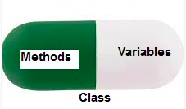

Slide 75
# Python program to
# demonstrate private members
# Creating a Base class
class Base:
def __init__(self):
self.a = "Pythonforprogrammers"
self.__c = "Python for programmers"
# Creating a derived class
class Derived(Base):
def __init__(self):

Slide 76
# Calling constructor of
# Base class
Base.__init__(self)
print("Calling private member of base class: ")
print(self.__c)
# Driver code
obj1 = Base()
print(obj1.a)
# Uncommenting will
print(obj1.c) # raise an AttributeError
# Uncommenting
obj2 = Derived() # also raise an AtrributeError as
# private member of base class
# is called inside derived class

Slide 77
Output:
Pythonforprogrammers
Traceback (most recent call last):
File "/home/f4905b43bfcf29567e360c709d3c52bd.py", line 25, in <module>
print(obj1.c)
AttributeError: 'Base' object has no attribute 'c'
Traceback (most recent call last):
File "/home/4d97a4efe3ea68e55f48f1e7c7ed39cf.py", line 27, in <module>
obj2 = Derived()
File "/home/4d97a4efe3ea68e55f48f1e7c7ed39cf.py", line 20, in __init__
print(self.__c)
AttributeError: 'Derived' object has no attribute '_Derived__c'

Slide 78
Example
class Product:
def __init__(self):
self.__maxprice = 1000
self.__minprice = 1
def sellingPrice(self):
print('Our product maximum price is: {}'.format(self.__maxprice))
print('Our product minimum price is: {}'.format(self.__minprice))
def productMaxPrice(self, price):
self.__maxprice = price

Slide 79
def productMinPrice(self, price):
self.__minprice = price
prod1= Product()
prod1.sellingPrice()
prod1.__maxprice = 1500
prod1.sellingPrice()
prod1.__minprice = 10
prod1.sellingPrice()

Slide 80
prod1.productMaxPrice(1500)
prod1.sellingPrice()
prod1.productMinPrice(10)
prod1.sellingPrice()
OutPut :
Our product maximum price is: 1000
Our product minimum price is: 1
Our product maximum price is: 1000
Our product minimum price is: 1
Our product maximum price is: 1000
Our product minimum price is: 1
Our product maximum price is: 1500
Our product minimum price is: 1
Our product maximum price is: 1500
Our product minimum price is: 10

Slide 81
Searching Algorithms :
Searching is a very basic necessity when you store data in different data structures. The simplest appraoch is to go across every element in the data structure and match it with the value you are searching for. This is known as Linear search. It is inefficient and rarely used, but creating a program for it gives an idea about how we can implement some advanced search algorithms.

Slide 82
Linear Search
In this type of search, a sequential search is made over all items one by one. Every item is checked and if a match is found then that particular item is returned, otherwise the search continues till the end of the data structure.

Slide 83
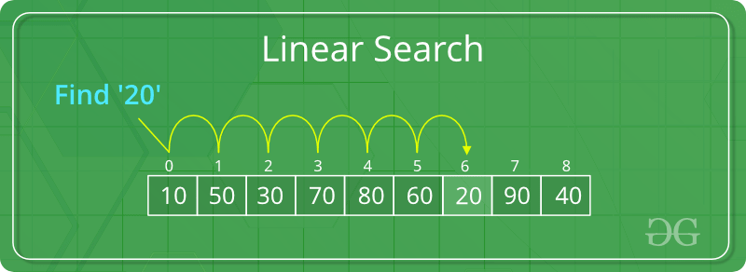
Linear Search to find the element “20” in a given list of numbers

Slide 84
def linear_search(values, search_for):
search_at = 0
search_res = False
# Match the value with each data element
while search_at < len(values) and search_res is False:
if values[search_at] == search_for:
search_res = True
else:
search_at = search_at + 1
return search_res
l = [64, 34, 25, 12, 22, 11, 90]
print(linear_search(l, 12))
print(linear_search(l, 91))

Slide 85
When the above code is executed, it produces the following result −
True
False

Slide 86
Understanding of Linear Search :
In linear search, we first start with index 0 and look for the element in the whole data structure until it's found or we reached the end of the data structure.
Suppose we have an array of integers as = [1,2,4,3,6,7,0,9] and we have to search 6 on the list. In the Linear approach, we first compare the number to search with the index 0 value if they are not equal we move a pointer to the next number and again compare we do the same steps until the number is found or we reached at the end of the array.

Slide 87
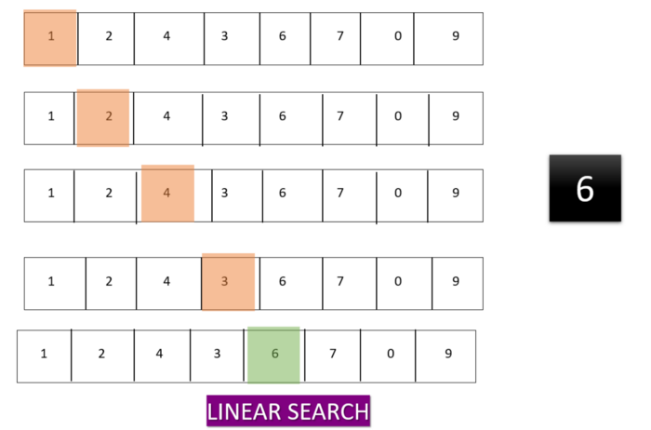

Slide 88
Script :
lst = [2,5,3,1,7]
num = 1
for index,value in enumerate(lst):
if num==value:
print(f"{value} found at position {index+1}")

Slide 89
Binary Search
In Binary Search, we first compare the number with the center or mid element which can be found using first+last//2. if the number is not equal to the center element then we check whether it is greater then the center element or smaller then the center element according to that we break the list into two parts and the side in which our element can not exist we stop searching on that side.

Slide 90
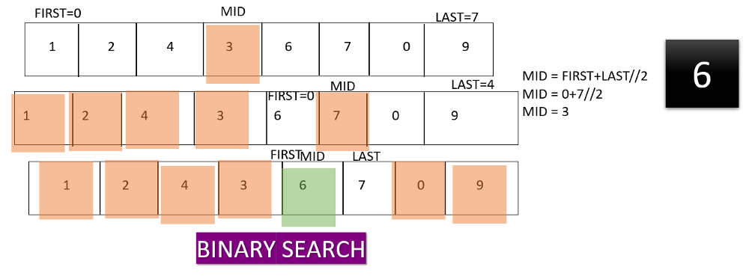

Slide 91
lst = [1,3,2,4,5,6,9,8,7,10]
lst.sort()
first=0
last=len(lst)-1
mid = (first+last)//2
item = 7
found = False
while( first<=last and not found):
mid = (first + last)//2
if lst[mid] == item :
print(f"found at location {mid+1}")
found= True
else:
if item < lst[mid]:
last = mid - 1
else:
first = mid + 1
if found == False:
print("Number not found")

Slide 92
Script :
lst = [1,3,2,4,5,6,9,8,7,10]
lst.sort()
first=0
last=len(lst)-1
mid = (first+last)//2
item = 7
found = False
while( first<=last and not found):
mid = (first + last)//2
if lst[mid] == item :
print(f"found at location {mid+1}")
found= True
else:
if item < lst[mid]:
last = mid - 1
else:
first = mid + 1
if found == False:
print("Number not found")

Slide 93
Sorting Algorithms :
Sorting refers to arranging data in a particular format. Sorting algorithm specifies the way to arrange data in a particular order. Most common orders are in numerical or lexicographical order.
The importance of sorting lies in the fact that data searching can be optimized to a very high level, if data is stored in a sorted manner. Sorting is also used to represent data in more readable formats.

Slide 94
Bubble Sort :
Bubble sort is an algorithm that compares the adjacent elements and swaps their positions if they are not in the intended order. The order can be ascending or descending.
How Bubble Sort Works?
Starting from the first index, compare the first and the second elements.If the first element is greater than the second element, they are swapped.
Now, compare the second and the third elements. Swap them if they are not in order.
The above process goes on until the last element.

Slide 95
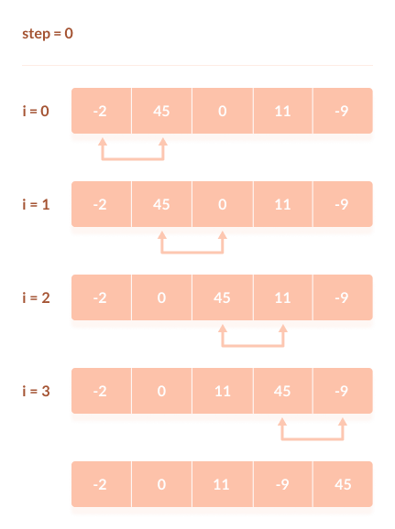

Slide 96
The same process goes on for the remaining iterations. After each iteration, the largest element among the unsorted elements is placed at the end.
In each iteration, the comparison takes place up to the last unsorted element.
The array is sorted when all the unsorted elements are placed at their correct positions.

Slide 97
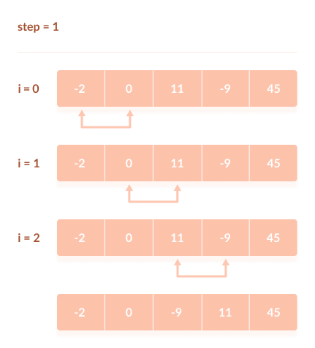

Slide 98
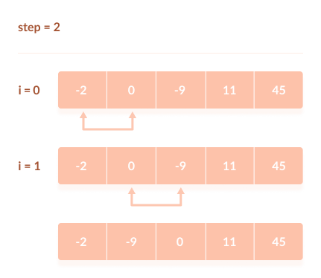

Slide 99
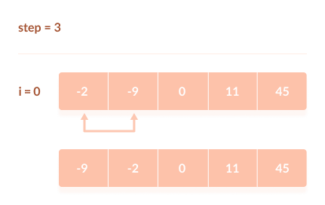

Slide 100
Bubble Sort Algorithm
bubbleSort(array)
for i <- 1 to indexOfLastUnsortedElement-1
if leftElement > rightElement
swap leftElement and rightElement
end bubbleSort

Slide 101
def bubbleSort(array):
# run loops two times: one for walking throught the array
# and the other for comparison
for i in range(len(array)):
for j in range(0, len(array) - i - 1):

Slide 102
# To sort in descending order, change > to < in this line.
if array[j] > array[j + 1]:
# swap if greater is at the rear position
(array[j], array[j + 1]) = (array[j + 1], array[j])
data = [-2, 45, 0, 11, -9]
bubbleSort(data)
print('Sorted Array in Asc ending Order:')
print(data)

Slide 103
Optimization of Python Code Implementation
We can optimize the above code using the two techniques. The swaps are not done; it means list is sorted. In the previous technique - The previous technique will evaluate the complete list though it doesn't seem necessary to do.
We can prevent the unnecessary evaluation using the Boolean flag and checks if any swaps were made in the previous section.
Example -
def bubble_sort(list1):
# We can stop the iteration once the swap has done
has_swapped = True

Slide 104
while(has_swapped):
has_swapped = False
for i in range(len(list1) - 1):
if list1[i] > list1[i+1]:
# Swap
list1[i], list1[i+1] = list1[i+1], list1[i]
has_swapped = True
return list1

Slide 105
list1 = [5, 3, 8, 6, 7, 2]
print("The unsorted list is: ", list1)
# Calling the bubble sort function
print("The sorted list is: ", bubble_sort(list1))
Output:
The unsorted list is: [5, 3, 8, 6, 7, 2]
The sorted list is: [2, 3, 5, 6, 7, 8]

Slide 106
Selection Sort :
In selection sort we start by finding the minimum value in a given list and move it to a sorted list. Then we repeat the process for each of the remaining elements in the unsorted list. The next element entering the sorted list is compared with the existing elements and placed at its correct position. So at the end all the elements from the unsorted list are sorted.

Slide 107
Selection sort is an algorithm that selects the smallest element from an unsorted list in each iteration and places that element at the beginning of the unsorted list.
How Selection Sort Works?
Set the first element as minimum.

Slide 108
Write a Python program to sort a list of elements using the selection sort algorithm.
Note : The selection sort improves on the bubble sort by making only one exchange for every pass through the list.

Slide 109
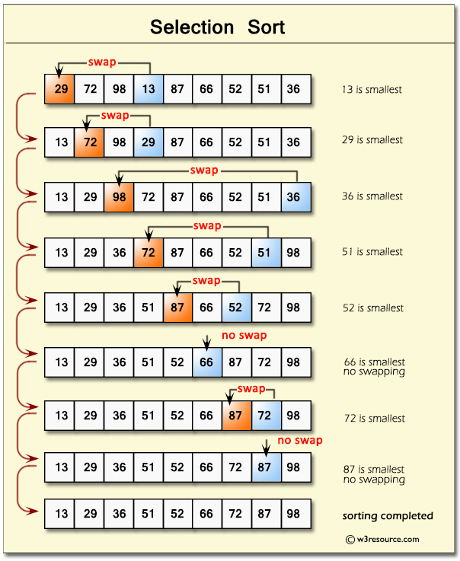

Slide 110
Code:
def selectionSort(nlist):
for fillslot in range(len(nlist)-1,0,-1):
maxpos=0
for location in range(1,fillslot+1):
if nlist[location]>nlist[maxpos]:
maxpos = location
temp = nlist[fillslot]
nlist[fillslot] = nlist[maxpos]
nlist[maxpos] = temp

Slide 111
nlist = [14,46,43,27,57,41,45,21,70]
selectionSort(nlist)
print(nlist)
Output:
[14, 21, 27, 41, 43, 45, 46, 57, 70]

Slide 112
Insertion Sort
Insertion sort is a simple sorting algorithm that works similar to the way you sort playing cards in your hands. The array is virtually split into a sorted and an unsorted part. Values from the unsorted part are picked and placed at the correct position in the sorted part.

Slide 113
Algorithm
To sort an array of size n in ascending order:
1: Iterate from arr[1] to arr[n] over the array.
2: Compare the current element (key) to its predecessor.
3: If the key element is smaller than its predecessor, compare it to the elements before.
Move the greater elements one position up to make space for the swapped element.

Slide 114
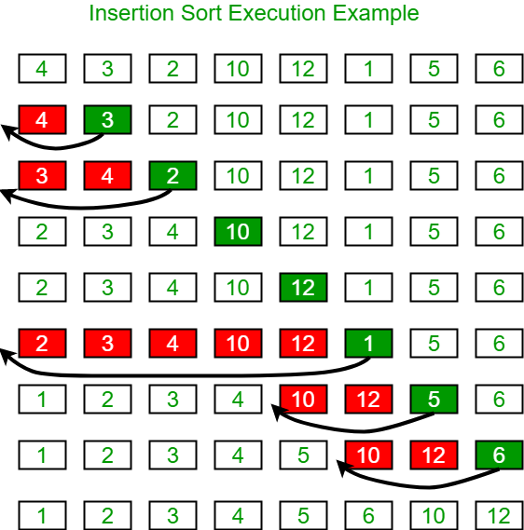

Slide 115
def insertionSort(arr):
# Traverse through 1 to len(arr)
for i in range(1, len(arr)):
key = arr[i]
# Move elements of arr[0..i-1], that are
# greater than key, to one position ahead
# of their current position
j = i-1
while j >=0 and key < arr[j] :
arr[j+1] = arr[j]
j -= 1
arr[j+1] = key

Slide 116
arr = [12, 11, 13, 5, 6]
insertionSort(arr)
print ("Sorted array is:")
for i in range(len(arr)):
print ("%d" %arr[i])

Slide 117
Output:
Sorted array is:
5
6
11
12
13

Slide 118
Hash Table
Data requires a number of ways in which it can be stored and accessed. One of the most important implementations includes Hash Tables. In Python, these Hash tables are implemented through the built-in data type i.e, dictionary.

Slide 119
Hash tables are a type of data structure in which the address or the index value of the data element is generated from a hash function. That makes accessing the data faster as the index value behaves as a key for the data value. In other words Hash table stores key-value pairs but the key is generated through a hashing function.

Slide 120
Hash tables or has maps in Python are implemented through the built-in dictionary data type. The keys of a dictionary in Python are generated by a hashing function. The elements of a dictionary are not ordered and they can be changed.

Slide 121
In Python, the Dictionary data types represent the implementation of hash tables. The Keys in the dictionary satisfy the following requirements.
The keys of the dictionary are hashable i.e. the are generated by hashing function which generates unique result for each unique value supplied to the hash function.
The order of data elements in a dictionary is not fixed.

Slide 122
Accessing Values in Dictionary
To access dictionary elements, you can use the familiar square brackets along with the key to obtain its value.
# Declare a dictionary
dict = {'Name': 'Zara', 'Age': 7, 'Class': 'First'}
# Accessing the dictionary with its key
print "dict['Name']: ", dict['Name']
print "dict['Age']: ", dict['Age']

Slide 123
Output :
dict['Name']: Zara
dict['Age']: 7

Slide 124
Updating Dictionary
You can update a dictionary by adding a new entry or a key-value pair, modifying an existing entry, or deleting an existing entry as shown below in the simple example −
# Declare a dictionary
dict = {'Name': 'Zara', 'Age': 7, 'Class': 'First'}
dict['Age'] = 8; # update existing entry
dict['School'] = "DPS School"; # Add new entry
print "dict['Age']: ", dict['Age']
print "dict['School']: ", dict['School']

Slide 125
Output :
When the above code is executed, it produces the following result −
dict['Age']: 8
dict['School']: DPS School

Slide 126
Updating Dictionary
You can update a dictionary by adding a new entry or a key-value pair, modifying an existing entry, or deleting an existing entry as shown below in the simple example −
# Declare a dictionary
dict = {'Name': 'Zara', 'Age': 7, 'Class': 'First'}
dict['Age'] = 8; # update existing entry
dict['School'] = "DPS School"; # Add new entry
print "dict['Age']: ", dict['Age']
print "dict['School']: ", dict['School']

Slide 127
Output :
When the above code is executed, it produces the following result −
dict['Age']: 8
dict['School']: DPS School

Slide 128
Delete Dictionary Elements
You can either remove individual dictionary elements or clear the entire contents of a dictionary. You can also delete entire dictionary in a single operation. To explicitly remove an entire dictionary, just use the del statement. −
dict = {'Name': 'Zara', 'Age': 7, 'Class': 'First'}
del dict['Name']; # remove entry with key 'Name'
dict.clear(); # remove all entries in dict
del dict ; # delete entire dictionary
print "dict['Age']: ", dict['Age']
print "dict['School']: ", dict['School']

Slide 129
Output :
ict['Age']:
Traceback (most recent call last):
File "test.py", line 8, in
print "dict['Age']: ", dict['Age'];
TypeError: 'type' object is unsubscriptable

Slide 130
Hash Table Implementation with Python Example
Let's look at a simple example that calculates the hash value of a key
def hash_key( key, m):
return key % m
m = 7
print(f'The hash value for 3 is {hash_key(3,m)}')
print(f'The hash value for 2 is {hash_key(2,m)}')
print(f'The hash value for 9 is {hash_key(9,m)}')
print(f'The hash value for 11 is {hash_key(11,m)}')
print(f'The hash value for 7 is {hash_key(7,m)}')

Slide 131
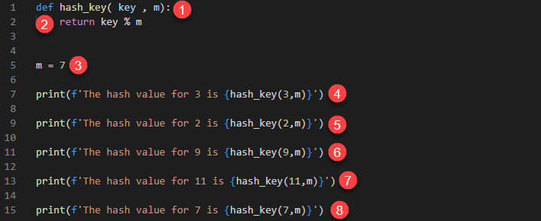
Explanation

Slide 132
HERE,
Defines a function hash_key that accepts the parameters key and m.
Uses a simple modulus operation to determine the hash value
Defines a variable m that is initialized to the value 7. This is the size of our hash table
Calculates and prints the hash value of 3
Calculates and prints the hash value of 2
Calculates and prints the hash value of 9
Calculates and prints the hash value of 11
Calculates and prints the hash value of 7

Slide 133
Output :
The hash value for 3 is 3
The hash value for 2 is 2
The hash value for 9 is 2
The hash value for 11 is 4
The hash value for 7 is 0

Slide 134
Advantages of hash tables
Here, are pros/benefits of using hash tables:
Hash tables have high performance when looking up data, inserting, and deleting existing values.
The time complexity for hash tables is constant regardless of the number of items in the table.
They perform very well even when working with large datasets.

Slide 135
Disadvantages of hash tables
Here, are cons of using hash tables:
You cannot use a null value as a key.
Collisions cannot be avoided when generating keys using. hash functions. Collisions occur when a key that is already in use is generated.
If the hashing function has many collisions, this can lead to performance decrease.

Slide 136
UNIT 2 COMPLETED

